Slide 1
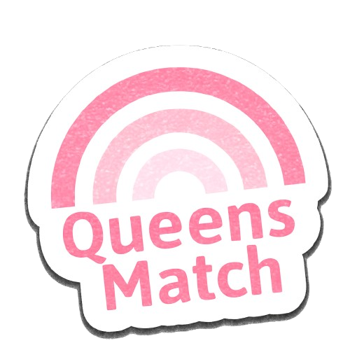







Ron Shukrun Hend Bishara Rotem Shapira

Slide 2

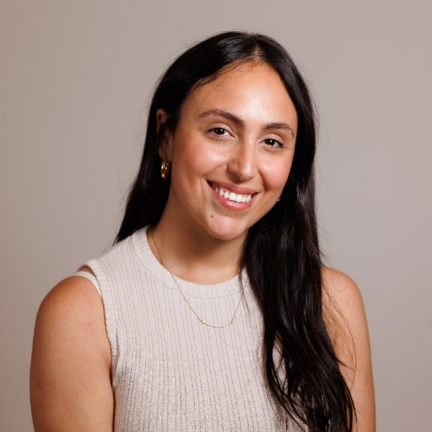
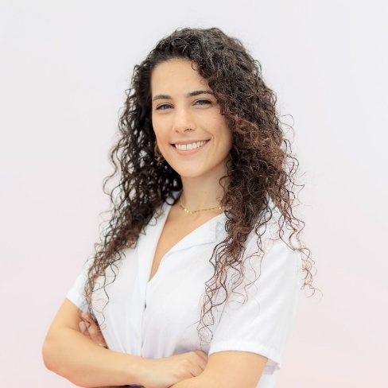
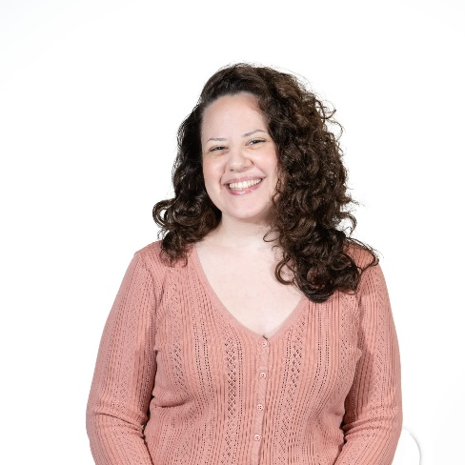
Nice to meet you
Ron Shukrun - B.Sc. Student in Information Systems Engineering, Ben-Gurion University.
Hend Bishara - B.Sc. in Computer Science, Tel Aviv University.
B.Sc. in Biology, Honor's research program, Tel Aviv University.
Rotem Shapira - B.Sc. in Computer Science, Technion - Israel Institute of Technology

Slide 3


What’s Queens Match all about
Queens Match is a mentorship platform designed to connect tech mentees with experienced female mentors.

Slide 4

Technologic
Frontend: React, Material UI
Backend: Node.js, Express
Database: MySQL
Axios, Context API

Slide 5

Live Demo: Queens Match in Action
CLICK HERE

Slide 6
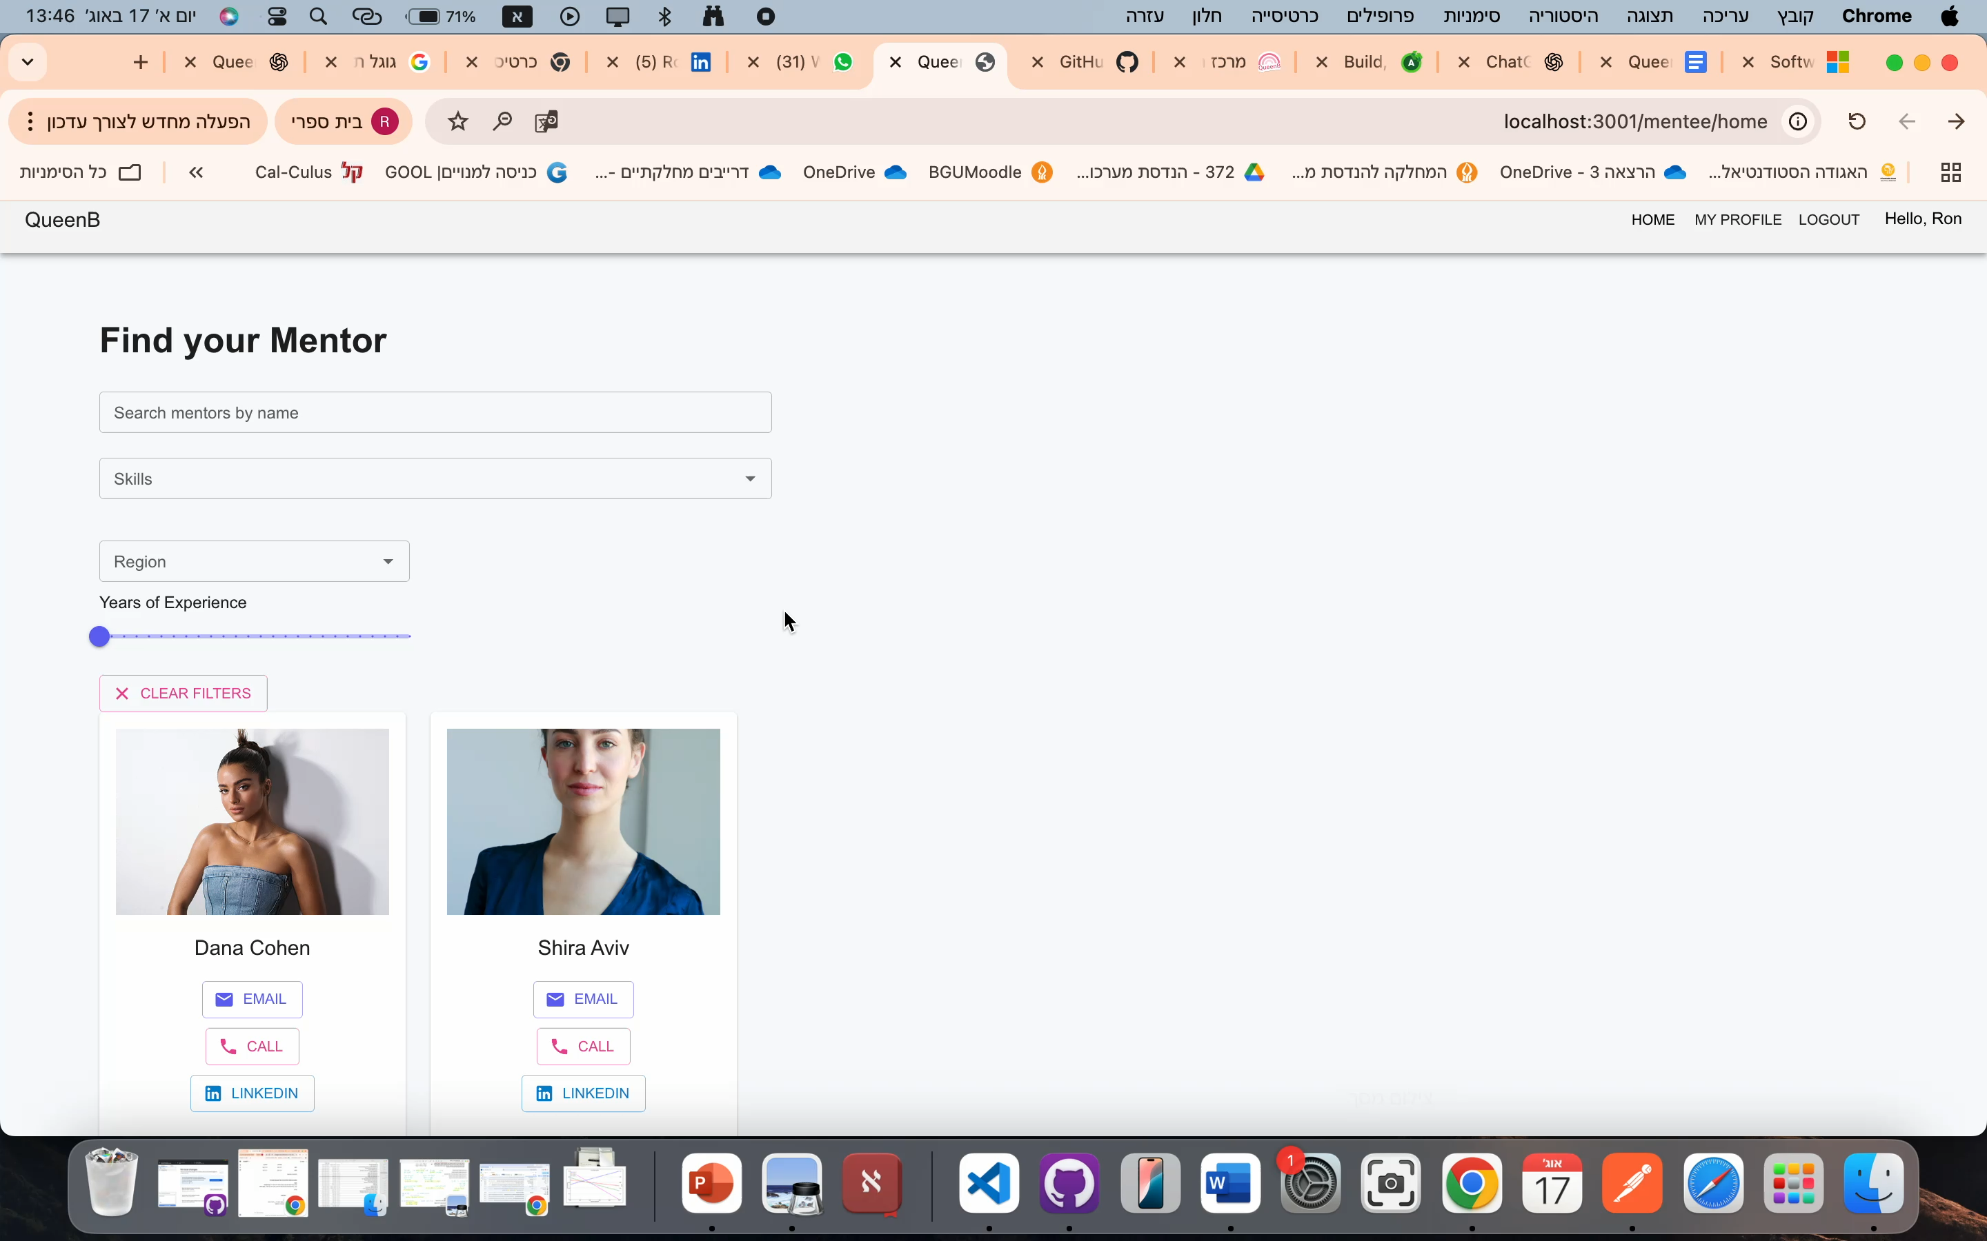
How It Works

Slide 7



The Road Ahead
Integrating with email notifications
1
Adding chat feature with mentors
2
Feedback for mentors/Rating
3

Slide 8
Growth through Challenges
1
Merging branches in Git ☺
2
Understanding and Using new Technologies
3
Team Work

Slide 9
Thank you!
Questions?
Ron Shukrun
Hend Bishara Rotem Shapira

